Slide 1


Habitual.AI
Make banking habits, automatically

Slide 2


3LOQ Founding Team
Sunil Motaparti & Anirudh Shah graduated together from Carnegie Mellon University.
Sunil Motaparti
Anirudh Shah
Their expertise lies in:
Machine Learning
Software development
Management
Co-Founder
Founder of 3LOQ, KeyPoint, Cafyne, Kagami, Altiux
Worked at IBM, Intel, Magma
Co-Founder
Built core technology at 3LOQ, KeyPoint and Cafyne
Worked at AMD, Synopsys
Notes:
Banking background: Chidara, Naveen

Slide 3
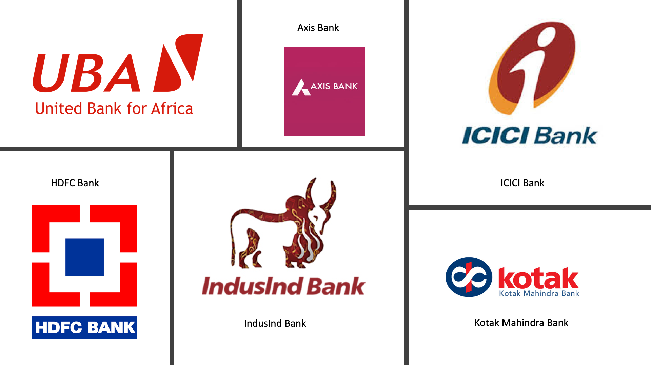
Current & Past Clients
Notes:
Banking background: Chidara, Naveen

Slide 4

What are Habits?
Habits are defined as repetitive behaviors done with little or no conscious thought.

Slide 5

How Are Habits Formed?
DISRUPT
The old behavior
ACTIVATE
The new behavior
REINFORCE
The new behavior
TRAIN
Through repetition
MAINTAIN
To Retain
Leverage the power of Artificial Intelligence to automate the process of building habits

Slide 6
Introducing Habitual.AI
Habitual.AI automates habit formation by:
Defining the parameters that quantify the habit based on transaction data.
Learning the path that existing habitual users took in their habit formation journey
Recommending product features that maximize likelihood of habit formation
Increased engagement
Reduced churn
Reduced customer irritation

Slide 7
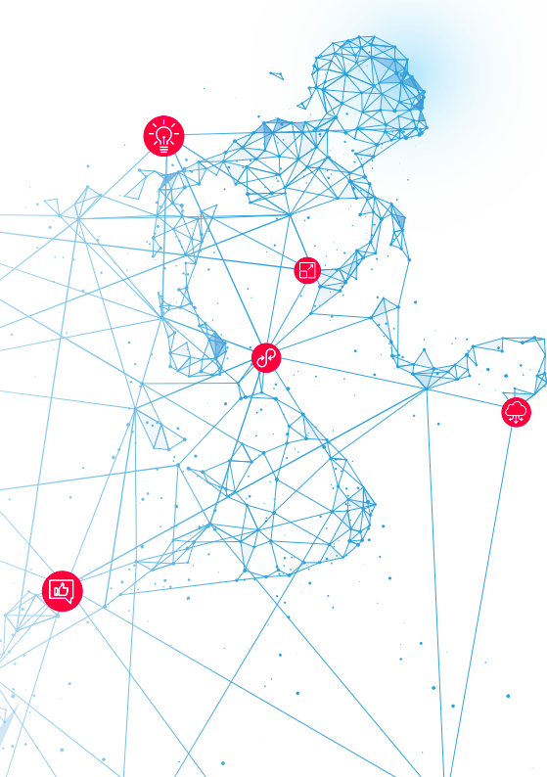
How Habitual.AI Automates the Customer Digital Banking Habits
Demographics
Behavior
Spend Categories
Channels
Banking Features
800 parameters for each customer
User Profile
5M Customers
24 Months
1TB Transaction Data
3.7M Unique Customer Paths
Identify Paths That Lead To Habit
ML
Big Data
Send recommendations to customers
Calculate Paths For Non-Habitual Customers
Game theory based, patent-pending algorithm ensemble

Slide 8
Habitual.AI Platform Tech Stack
Facebook Custom Audience
DASH BOARD
Email / SMS
Enterprise Data Warehouse
ETL
Data
Lake
Automation
Controller
OLAP
Relationship Manager (Call Center)
Data Connectors
Enterprise
Campaign Engine
SPARK
KAFKA/HDFS
AIRFLOW
POSTGRES
REST
API
Mobile Push Notification
3LOQ
3LOQ
Streaming Data from mobile/web SDK
Transaction Categorization
In-App Notification
Habitual.AI
Multi-lingual Bot
3LOQ
3LOQ
3LOQ
Notes:
31/08/16
8
8

Slide 9
Habitual.AI
Case Study: Digital Banking

Slide 10
List of Features
Description
ATM - Balance Check
ATM - Bill payment
ATM - CASA Administration
ATM - Cash withdrawal
ATM - Fund Transfer
BRANCH - ASSET Product
BRANCH - Balance Check
BRANCH - Billpay
BRANCH - CASA Administration
BRANCH - Cash
BRANCH - FOREX Product
BRANCH - Fund Transfer
BRANCH - Fund Transfer NEFT
BRANCH - Fund Transfer RTGS
BRANCH - Investment Product
BRANCH - Liability Product
BRANCH - Non Digital Payments (cheque, DD, etc)
BRANCH - Standing Instruction
Description
DIGITAL - Asset product
DIGITAL - Balance Check
DIGITAL - Bill Pay
DIGITAL - CASA Administration
DIGITAL - FOREX
DIGITAL - Fund Transfer
DIGITAL - Fund Transfer NEFT
DIGITAL - Fund Transfer RTGS
DIGITAL - Investment Product (MF, DEMAT)
DIGITAL - Liability Product (FD, RD)
DIGITAL - Misc
DIGITAL - Non Digital Payment (DD, MC, etc)
DIGITAL - Payments and Shopping
DIGITAL - IMPS/BHIMA
DIGITAL - Standing Instruction
POS - Cash
POS-Payment & Shopping

Slide 11
How Does Habitual.AI Work?
Input
Habitual.AI
Output
AI learns feature journeys from historical data of existing habitual users
AI dynamically creates feature journeys for users that lead to user forming a habit
For given user: find the next feature user should use that increases chances of forming a habit
User Id | Habitual.AI First Step
56241091 | Fund Transfer (IMPS/Wallet) on Digital Banking
51820312 | Shopping on Debit Card
38628611 | Shopping on Debit Card
23782516 | Investment Product on Digital Banking
3647962 | View Statement on Digital Banking
41257516 | Bill Payments on Digital Banking
Financial Transaction Data
Demographic Data
Non-Financial Transactions
DIGITAL banking Usage Transaction Data
Notes:
31/08/16
11
11

Slide 12
Habitual Journey for Digital Banking
Habitual AI First Step
Habitual AI Second Step
User’s Existing Profile
User’s Existing Feature Usage
Habitual AI Third Step
Habitual Journey Continues
Do Balance Inquiry using Digital Banking
Already Withdrawing Cash on ATMs
Make an online purchase
Make purchase using Debit Card
User who is new to bank
Make purchase using Debit Card
Already using Balance Inquiry on Internet Banking
Make an online purchase
Invest in FD/RD using Digital Banking
User who is new to Digital Banking
Do Balance Inquiry using Digital Banking
Already using Billpay Service
Transfer funds to your friend using Digital Banking
No Recommendation
Digital User but not engaged with bank
Check Balance on Digital Banking
Using Cash Deposit/Withdrawal on Branches
Make Purchase on Debit Card
Make purchase using Digital Banking
Non-Digital User of bank

Slide 13
Habitual.AI adapts to change in user behavior
Habitual.AI First Recommendation
User’s Existing Feature Usage
Subsequent user action
Habitual AI New Recommendation
User’s Existing Profile
Do Balance Inquiry using Digital Banking
Already using standing instruction
Shopping using Debit Card
Make purchase using Digital Banking
Digital User but not engaged with bank
Make Purchase using Debit Card
Already using for salary credit, ATM cash withdrawal, checking balance on Digital Banking and purchase using Digital Banking
Booked RD,Used Bill Pay and started standing instruction using Digital Banking
Invest in Mutual fund using Digital Banking
Digital User and highly engaged with bank

Slide 14
Habitual.AI Claim
When a non-habitual* user uses the recommended feature, it leads to a 50% or more increase in digital banking transactions in subsequent month, thereby increasing customer’s probability of becoming a habitual user of digital banking.
*Non-Habitual user = less than 2 digital transactions per month on average

Slide 15


Results Setup
Group A:
Used the recommended feature
Test Base
Group B:
Did not use the recommended feature
Control Base
List of Recommended Features
ATM: BILLPAY
BRANCH: FUND TRANSFER VIA NEFT
DIGITAL: CHECK BALANCE
DIGITAL: FUND TRANSFER
DIGITAL: INVESTMENT PRODUCT
DIGITAL: BILLPAY
DIGITAL: LIABILITY PRODUCT
DIGITAL: PAYMENTS SHOPPING
DIGITAL: SMALL FUND TRANSFER
DIGITAL: STANDING INS
POS: PAYMENTS SHOPPING
Note: Recommended feature had not been used by user in the last 6 months

Slide 16
Change in Digital Transaction Count
Pre VS Post Recommendation
Key Takeaways:
145% increase in Group A’s Median Digital Banking Transactions
Slight decline in Group B’s Median Digital Banking Transactions
145%
-8%

Slide 17
Change in Number of Unique Customers Using Banking Features
Pre VS Post Recommendation

Slide 18
Feature-wise Campaign Impact
June 2018
Habitual.AI Recommendation | Email Open Rate | URL Click Thru Rate | Increase in Digital Banking Transactions for users who followed Habitual.AI recommendations (Group A)
Net Banking: Check Balance | 44% | 5% | 200%
Net Banking: Billpay | 48% | 4% | 133%
Net Banking: Fund Transfer | 54% | 6% | 100%
Net Banking: Investment Product | 45% | 1% | 60%
Net Banking: Fixed/Recurring Deposits | 44% | 1% | 30%
Net Banking: Shopping | 49% | 4% | 75%
Net Banking: Small Fund Transfer (IMPS) | 52% | 4% | 80%
Net Banking: Standing Instructions | 49% | 3% | 57%

Slide 19
Habitual.AI
Case Study: Credit Cards

Slide 20
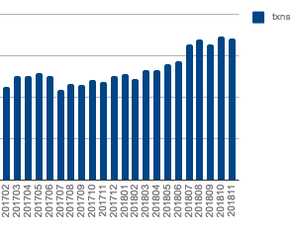
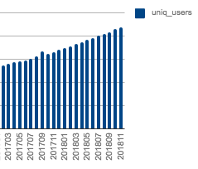
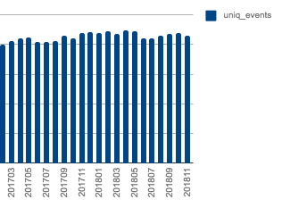
Data Summary
Data period: February 2017 – November 2018
Number of unique users: 1.5M
Number of transactions: 295M
Number of transactions
Number of unique users
Number of unique events

Slide 21
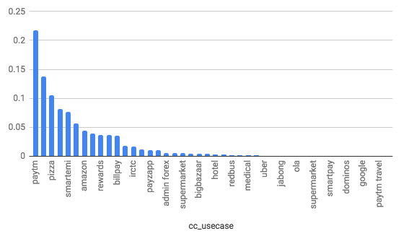
Habitual Index: Activities That Are Leading Indicators of Habit Formation
3LOQ’s proprietary algorithm Habitual.AI identified activities that are most indicative of loyalty, habitual credit card users in the future.
Some of the habit-forming credit card use-cases are PayTM, Pizza, Smart EMI, Amazon & Rewards.

Slide 22
Habitual Index for Platinum Cards for New Customers*: Activities That Are Leading Indicators of Habit
3LOQ’s proprietary algorithm Habitual.AI identified activities that are most indicative of loyalty, habitual credit card users in the future.
Compared to the behaviour of the overall base, the behaviour of premium differs widely and with clothing (Myntra, an online fashion retailer), telecom taking the top spots.
* Joined less than 4 months ago

Slide 23

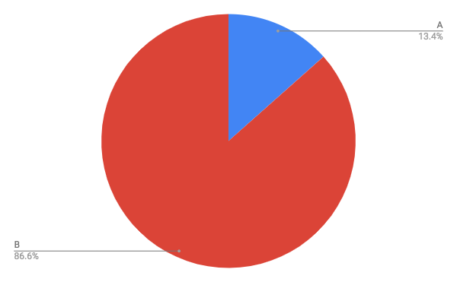
Results Setup
For this report, 3LOQ has identified two key customer personas, A and B.
Group A: Customers who followed the feature recommendation.
Group B: Customers who did not follow the feature recommendation.
Out of 1.5M users:
Group A comprised of 13.4% of the total recommended user base.
Group B comprised of 86.6% of the total recommended user base.
Note: Habitual.AI recommends features that have not been used in the past.

Slide 24
Overall Change in the Number of Credit Card Transactions Post-recommendation
There was a 54.3% increase in Group A's median credit card transaction count post-recommendation. It is notable that this is a dramatic lift over the 3.63% increase in the BAU median transaction count during the same period.
On the other hand, Group B users exhibited a decline of 4.9% in their median credit card transaction count.

Slide 25
Change in Credit Card Expenditure Post-recommendation
Group A's median spend amount on credit cards increased by a strong 65.4% post-recommendation. This increase greatly outperformed the BAU increase of 13.5% during the same period.
Group B users came in last, with an increase of 4.2% in their median credit card spend amount for the same period.

Slide 26
Change in the Variety of Credit Card Transactions Post-recommendation
There was a 27.9% increase in Group A's unique events count post-recommendation, showing a significant increase in the variety of credit card transactions. Group A users were the only pool to display in increase in unique events count during this period.
The BAU unique events count fell by 0.48%. Group B users performed slightly worse, with their unique events count clocking a decline of 0.6% for the same period.

Slide 27
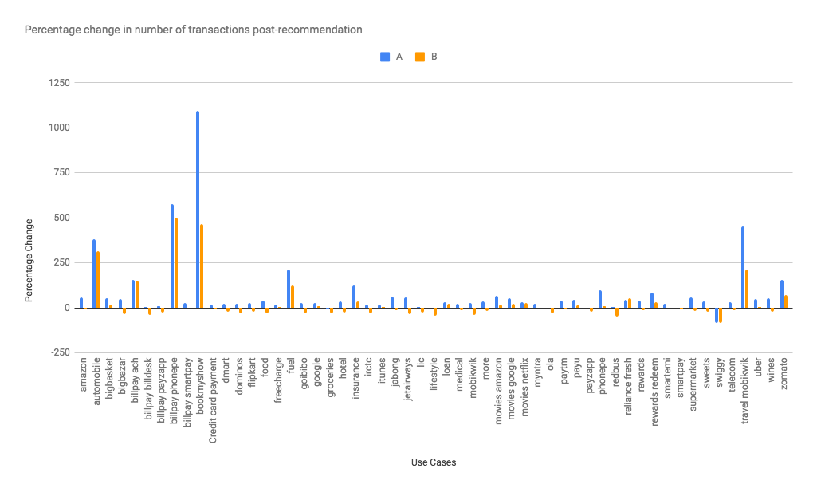
Change in the Number of Credit Card Transactions Post-recommendation
Credit card customers who followed Habitual.AI recommendations displayed a healthy increase in the number of credit card transactions, across a variety of use cases.
The use cases which benefited the most were Book My Show, Bill Pay Phone Pe, Travel MobiKwik and Automobile.
The increase in the number of credit card transactions for Group A consistently outperformed the same metric for Group B, across a range of use cases.

Slide 28
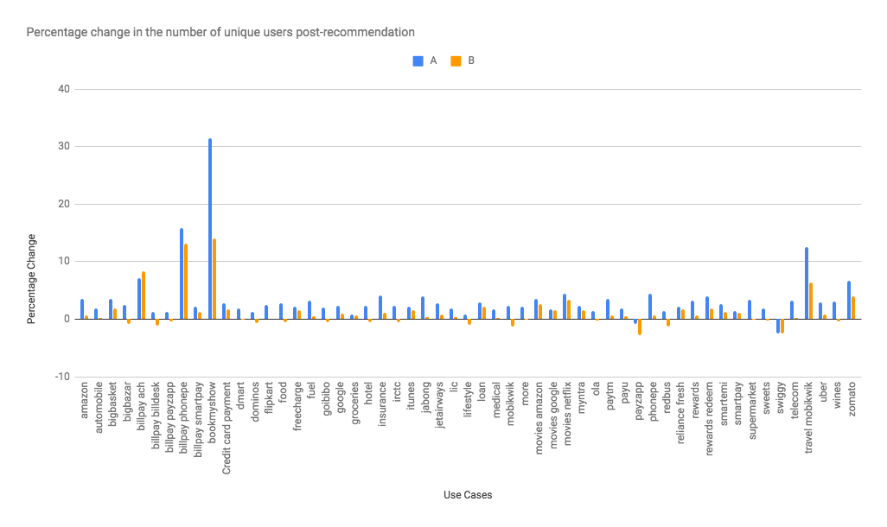
Change in the Number of Unique Credit Card Users Post-recommendation
The Group A pool which followed Habitual.AI recommendations, showed a robust increase in the number of unique users, across a range of use cases.
The use cases which saw the greatest surge in the increase of unique users post-recommendation were Book My Show, Bill Pay on Phone Pe and MobiKwik (Travel).
The overall increase in the number of unique users was significantly higher for Group A compared to Group B.

Slide 29
Habitual.AI Advantage
Business Benefits
Decrease in attrition rate
Increase in engagement rate while reducing marketing expenses
Marketing Benefits
Fostering Habitual customers: Focused on long term business value
Customer-centric communication: Customer finds marketing messages useful and interesting
Notes:
Why invest in 3LOQ:
Industry first artificial intelligence engine that builds habits
Artificial intelligence platform, proven at scale in the largest bank in India
Pioneering intent detection based on transaction data categorization
World class team of technologists and domain experts
Fund Usage
Client acquisition: India (3), US(2), Africa(3)
Sales
Account management
Marketing
Marketing Manager
Marketing Campaigns
Agency
Expansion in US
Technology team scale up

Slide 30
Why Habitual.AI
Make new customer habits at scale, automatically
More that 25 million customer habits tracked and analysed
More than 1 million new customer habits created in a period of 12 months
Manage complexity of habit formation process
Cutting edge, patent-pending AI that combines game theory and machine learning to understand how individuals build habits over long periods of time.
Individualized
Prescribes habit formation journey for each customer, constantly adapting to changing customer habits.
Notes:
Key USP:
AI cleverness
Technology USP:
Why invest in 3LOQ:
Industry first artificial intelligence engine that builds habits
Artificial intelligence platform, proven at scale in the largest bank in India
Pioneering intent detection based on transaction data categorization
World class team of technologists and domain experts
Fund Usage
Client acquisition: India (3), US(2), Africa(3)
Sales
Account management
Marketing
Marketing Manager
Marketing Campaigns
Agency
Expansion in US
Technology team scale up

